Slide 1
Design and Implementation of Database for ZipCar
Database specialist
Members:
Kejie‎ Chen (kc10511n@pace.edu)
Divya Bishnoi(db69772n@pace.edu)
Nusrat Jahan(nj23261n@pace.edu)
Abrefa Ansah(ya96827n@pace.edu)

Slide 2
Background
Zipcar is a car rental company in the United States, a subsidiary of Avis Budget Group.
Zipcar provides automobile reservations to its members, billable by the hour or day.
Zipcar members pay a monthly or annual membership fee in addition to car rental charges.

Slide 3
Problem Description
. Existing system does not allow members to return cars in different locations.
. Current Zipcar system is not providing different types of promotional offers and also does not keep any transaction history.

Slide 4
Goals and objective
Zipcar’s mission is to enable simple and responsible urban living. Our objectives are the following :to build trust and confidence among our member community by delivering leading convenience, dependability and service excellence.

Slide 5
Sample Entity Description
MEMBER
Field | Description
MEMBER_ID | Unique ID of an indidivual member.
MEMBER_FNAME | Firsr name of the member.
MEMBER_LNAME | Last name of the member.
MEMBERSHIP_TYPE | Category of different membership.
MEMBERSHIP_STARTDATE | Date when customer became member.
MEMBERSHIP_EXPDATE | Date when membership ends.
MEMBER_DOB | Date of birth of the member.
MEMBER_DLNUMBER | Driver licence of the member.

Slide 6
SampleEntity Description
RESERVATION
Field | Description
RESERVATION_ID | Unique ID of an individual reservation.
MEMBER_ID | Unique ID of an indidivual member.
CAR_ID | Unique ID of an indidivual car.
TIME_INDEX | 24 hours index.
TIME_DESCRIPTION | Description of time index.
RESERVATION_DATE | Date when a member makes a reservation.

Slide 7
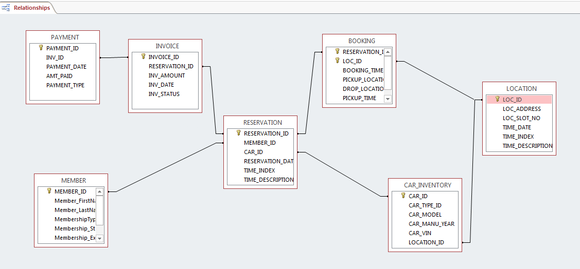
Updated Relational diagram (SQL view)

Slide 8
Entity Relationship Diagram (ERD Model):

Slide 9
SQL Statement: Create EMPLOYEE Table and Insert data into it:
INSERT INTO CAR_INVENTORY VALUES (‘30001’, ‘20005’, ‘Toyota Corolla’, ‘2013’, ‘ACB2345’, ‘10006’);
INSERT INTO CAR_INVENTORY VALUES (‘30002’, ‘20004’, ‘Nissan Altima’, ‘2015’, ‘GUG452’, ‘10005’);
INSERT INTO CAR_INVENTORY VALUES (‘30003’, ‘20006’, ‘Mercedes Benz Eclass’, ‘2014’, ‘TYF11’, ‘10002’);
INSERT INTO CAR_INVENTORY VALUES (‘30004’, ‘20001’, ‘Ford Fiesta’, ‘2013’, ‘GUG889’, ‘10004’);
INSERT INTO CAR_INVENTORY VALUES (‘30005’, ‘20002’, ‘Ford Focus’, ‘2013’, ‘HYT865’, ‘10005’);
INSERT INTO CAR_INVENTORY VALUES (‘30006’, ‘20005’, ‘Chevvy Impala’, ‘2013’, ‘JTW887’, ‘10002’);
INSERT INTO CAR_INVENTORY VALUES (‘30007’, ‘20005’, ‘Hyundai Genesis’, ‘2015’, ‘GML8996’, ‘10003’);
INSERT INTO CAR_INVENTORY VALUES (‘30008’, ‘20004’, ‘Hyundai Sonata’, ‘2015’, ‘BUK3546’, ‘10005’);
INSERT INTO CAR_INVENTORY VALUES (‘30009’, ‘20004’, ‘Ford Fusion’, ‘2014’, ‘SWR863’, ‘10006’);
INSERT INTO CAR_INVENTORY VALUES (‘30010’, ‘20002’, ‘Hyundai Elantra’, ‘2013’, ‘HYQ4452’, ‘10001’);
INSERT INTO CAR_INVENTORY VALUES (‘30011’, ‘20003’, ‘Toyota Camry’, ‘2015’, ‘FGE25’, ‘10001’);
INSERT INTO CAR_INVENTORY VALUES (‘30012’, ‘20006’, ‘BMW 5 Series’, ‘2014’, ‘FSO677’, ‘10003’);
INSERT INTO CAR_INVENTORY VALUES (‘30013’, ‘20005’, ‘Honda Accord’, ‘2013’, ‘NAQ1264’, ‘10004’);
INSERT INTO CAR_INVENTORY VALUES (‘30014’, ‘20005’, ‘Nissan Maxima’, ‘2013’, ‘GLM234’, ‘10006’);
CREATE TABLE CAR_INVENTORY
(CAR_ID INTEGER Not Null PRIMARY KEY,
CAR_TYPE_ID VarChar (255) Not Null,
CAR_MODEL VarChar (255) Not Null,
CAR_MANU_YEAR INTEGER Not Null,
CAR_VIN varchar(255) Not Null,
LOCATION_ID INTEGER Not Null);

Slide 10
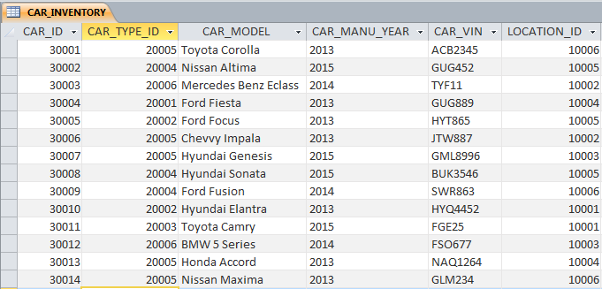
CAR_INVENTORY table (structure and data):

Slide 11

Test SQL Query
On designed database
Q. Give total payment for a specific date
Query:
SELECT PAYMENT_DATE, SUM(AMT_PAID) AS TOTAL
FROM PAYMENT
WHERE PAYMENT_DATE=#4/15/2015#
GROUP BY PAYMENT_DATE;

Slide 12

Test SQL Query
On designed database
Q. Which car people like most to pick up?
Query:
SELECT TOP 2 CAR_MODEL FROM
(SELECT CAR_MODEL , COUNT(RESERVATION_ID)
FROM RESERVATION INNER JOIN CAR_INVENTORY
ON CAR_INVENTORY.CAR_ID = RESERVATION.CAR_ID
GROUP BY CAR_MODEL
ORDER BY COUNT(RESERVATION_ID) DESC);

Slide 13

Test SQL Query
On designed database
Q. Which location people like most to pick up the car from?
Query:
SELECT TOP 2 LOC_ADDRESS FROM
(SELECT LOC_ADDRESS , COUNT(RESERVATION_ID)
FROM BOOKING INNER JOIN LOCATION
ON BOOKING.LOC_ID = LOCATION.LOC_ID
WHERE PICKUP_LOCATION = TRUE
GROUP BY LOC_ADDRESS
ORDER BY COUNT(RESERVATION_ID) DESC);

Slide 14

Test SQL Query
On designed database
Q. Give how many people are choosing different dropping location than pickup location?
Query:
SELECT COUNT(RESERVATION_ID) AS DIFFERENTDROPOFFTHANPICKUP FROM
(SELECT RESERVATION_ID FROM BOOKING
WHERE (PICKUP_LOCATION = TRUE AND DROP_LOCATION = FALSE)
OR (PICKUP_LOCATION = FALSE AND DROP_LOCATION = TRUE)
GROUP BY RESERVATION_ID);

Slide 15
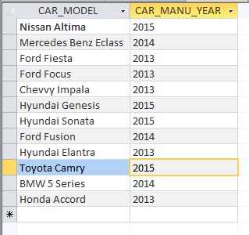
Test SQL Query
On designed database
Q. I want to book a car for 4-6pm, what are the available car options?
Query:
SELECT CAR_MODEL, CAR_MANU_YEAR
FROM CAR_INVENTORY WHERE CAR_ID NOT IN
(SELECT CAR_INVENTORY.CAR_ID FROM CAR_INVENTORY
INNER JOIN RESERVATION
ON CAR_INVENTORY.CAR_ID = RESERVATION.CAR_ID
WHERE RESERVATION.TIME_INDEX LIKE '*4/5/*');

